Slide 1
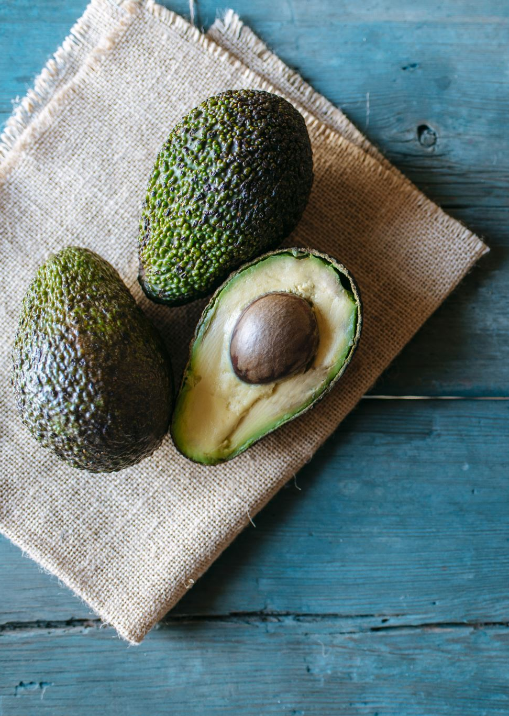
AVOCADO SALES 2015-2018
A report by
Wesley faulkner
Notes:
The purpose of this report is to find trends in sales over the past 4 years, and which seasons would be best to target for higher sales.

Slide 2
Sales over past 4 years
Notes:
We can see a clear fall off in sales, possibly due to immigration during the first Trump administration.

Slide 3
Sales by month
Notes:
Clear indication sales are highest during late January and early February probably due to watch parties for events such as the Super Bowl. We can also see a midyear spike in May probably associated with Cinco de Mayo.

Slide 4
Sales by bag size
Notes:
Small bags are the clear big seller, possibly due to shelf life of the item.

Slide 5
Sales by region
Notes:
No surprise here that the southwest and west regions are clearly the largest U.S. consumer of avocado’s.

